Slide 1

Data Mining – Decision Trees
Subashree BhaskaraN 10-SEP-2020

Slide 2
About Me
13+ years of Business Analysis, Data Engineering, Quality Engineering, Model Building / Validation and Project Management experience in India and the USA
Independent consultant in Data Science & Business Analytics
Completed Great Lakes PGP-BABI in Jan 2020 - ePortfolio
LinkedIn

Slide 3
Data Mining - Intro
Process of discovering patterns in large data sets involving methods at the intersection of machine learning, statistics, and database systems.
Knowledge Discovery in Data (KDD)
Job duties include but not limited to:
Store/Manage data, Analyze trends & Patterns
Statistical techniques to create algorithm & models
Create Visualization & Strategic recommendations
Elicit logical reasoning from data that impacts business
Notes:
Identify Outliers and Anomalies and recognize patterns
Data driven insights and decisions
SQL + Python is a great combination skillset

Slide 4
Decision tree
Predictive modelling tool
Non-parametric Supervised Learning
Algorithmic approach to split the data
Binary / Multiway splitting
Widely used in many applications
Great Interpretability
Handles categorical & numerical data
Illustration - DT to decide playing Badminton on any given day

Slide 5
Decision Tree applications
Classification
REGRESSION
Spam / Not Spam
Lend Loan / Reject Application
Fraudulent transactions detection
Credit Delinquency Prediction
Predict Stock returns
Predict Sports scores
Housing price prediction
Weather predictions

Slide 6
Classification Decision treeS
CHAID - Chi-squared Automatic Interaction Detection
Multiway Splits – Recursive partitioning algorithm
Chi-Square independent tests decides the best split
CART – Classification And Regression Trees
Binary Splits based on Gini Impurity, Entropy or Variance reduction computation
Cross Validation techniques
C4.5
Windowing – Builds tree with a subset of training data & validates against the rest
Gain Ratio is the splitting criterias
Notes:
CHAID – it chooses the independent variable that has the strongest interaction with the dependent variable.

Slide 7
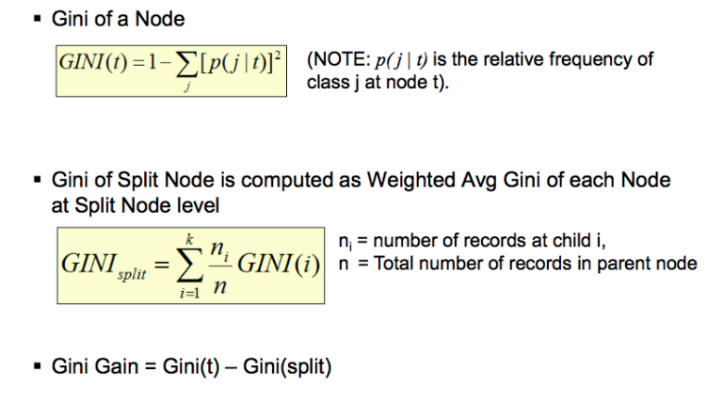
DECISION TREE (CART)
Binary split
Gini Index as default algorithm
Gini Index – Measure of Impurity
Notes:
Gini Index: A measure of how often a randomly chosen element from the set would be incorrectly labelled if it was randomly labelled according to the distribution of labels in the subset.

Slide 8
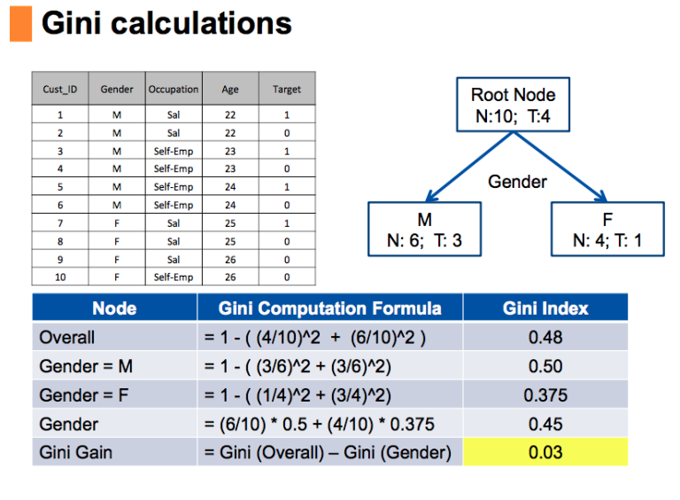

Slide 9
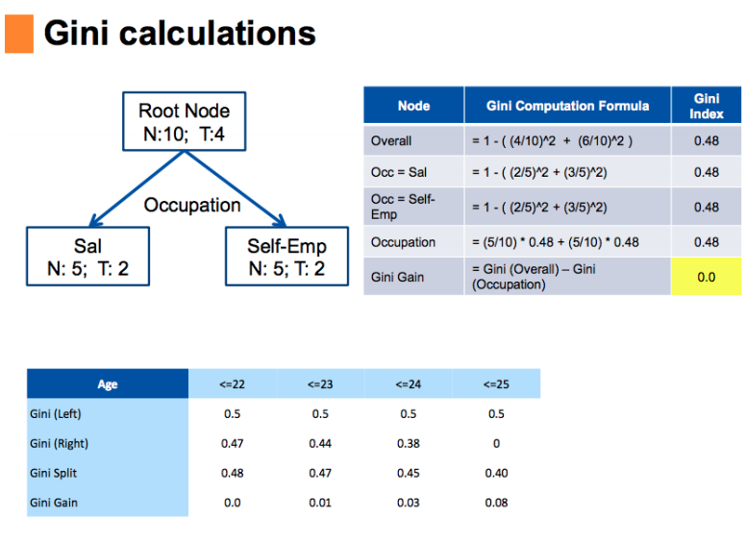

Slide 10
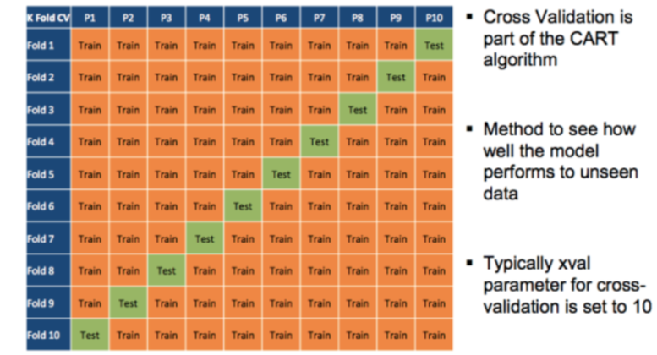
Decision tree – CROSS VALIDATION

Slide 11
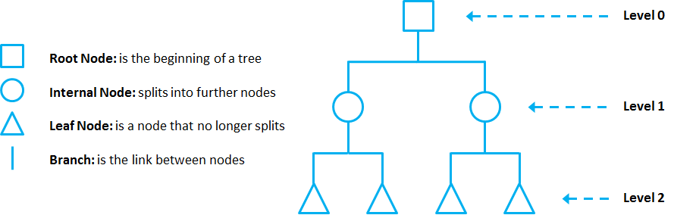
Decision tree - OVERfitting
Overfitting refers to a model that learns the training data (the data it uses to learn) so well that it has problems to generalize to new (unseen) data.
Prunning - Pruning is a technique used to deal with overfitting, that reduces the size of DTs by removing sections of the Tree that provide little predictive or classification power.

Slide 12
MODEL EVALUATION
Hyper Parameter Tuning
Control the behavior of training algorithm and helps improve performance on unseen data
GridSearchCV
finds the best parameters
Finds the best split points
Confusion Matrix
ROC Curve
AUC
PR Curve

Slide 13
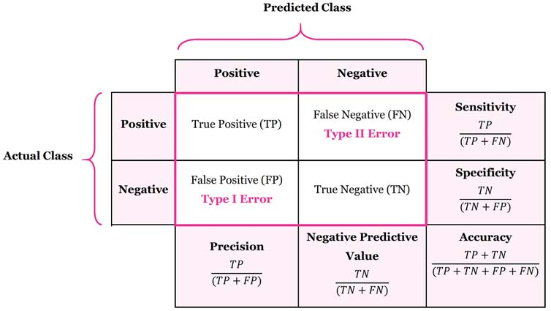
Confusion matrix

Slide 14
HANDS- ON

